Slide 1
Docker POC
CICD

Slide 2
CICD setup Infra
Ala-eu4-a1081 as a Jenkins node
https://dle-eu4-a1081:8443/#browse/browse/components Nexus docker hub hosted within a container, as a temp solution, since our Development environment needs to be setup with SSL.
Jenkins server/job: http://essjenkins:8080/jenkins/job/CICD_BOOTSTRAP/job/Docker-POC/job/Docker-ldng-ui-web_java_build/6/consoleFull

Slide 3
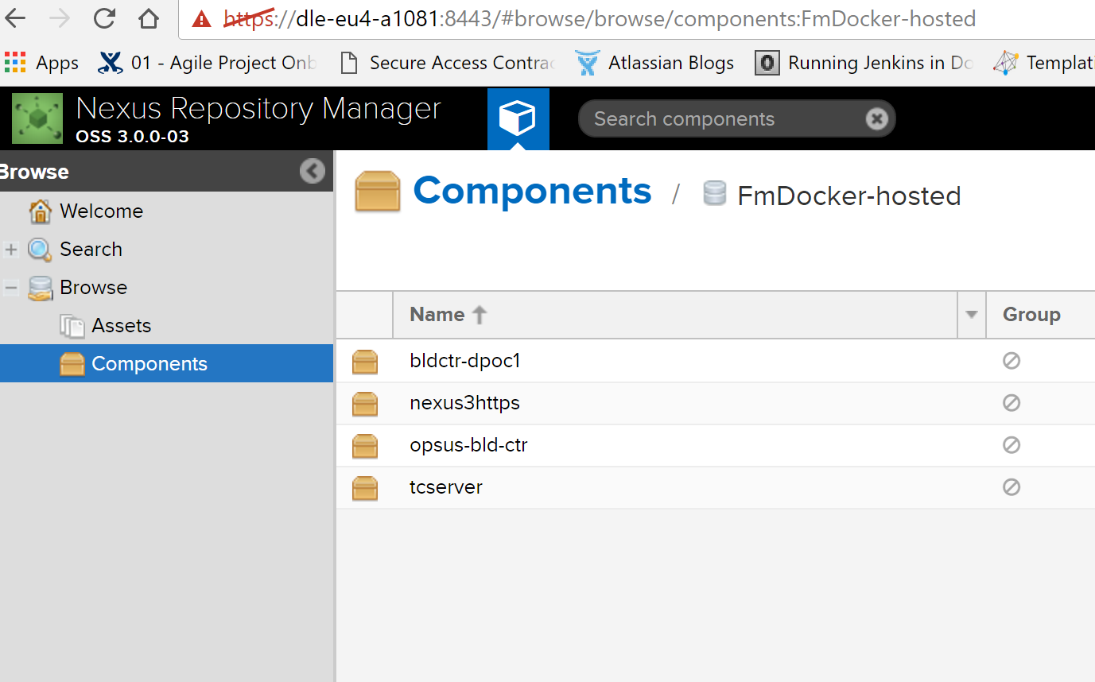
Docker images on Nexus:

Slide 4
Nexus login/push/pull details
admin/admin123
docker login https://10.215.60.134:18444 command to login from your docker host.
Push an image: docker tag bldctr-dpoc1 10.215.60.134:18444/bldctr-dpoc1 and docker push 10.215.60.134:18444/bldctr-dpoc1
Pull an image: docker pull 10.215.60.134:18444/bldctr-dpoc1
Currently two docker hosts are connected to docker hub, dle-eu4-a1081 and ala-eu4-a265.

Slide 5
Docker images
Two docker images have been created, for CICD for java component.
Tcserver→ tomcat server for deployments and bldctr-dpoc1 for builds.
Bldctr-dpoc1 image has an associated Dockerfile, which can be used to create the same image and ad additional tools dynamically based on application needs.
Tcserver also has a Dockerfile associated, and will spin up a container with FanniMae approved tpmcat software.

